Slide 1
Introduction To Programming

Slide 2
Content
2D Arrays

Slide 3
2D Arrays
Two-dimensional arrays can be described as "arrays of arrays".
To declare a 2D array, define the variable type, specify the name of the array followed by square brackets which specify how many elements the main array has, followed by another set of square brackets which indicates how many elements the sub-arrays have:
Syntax-
Datatype array_name [array size][array size];

Slide 4
2D Arrays...
Assigning values at the time of declaring a two-dimensional array can be any one of the following ways:
int arr[3][5] = {1,2,3,4,5,2,4,6,8,1,3,6,9,2,5};
int arr[3][5] = {{1,2,3,4,5},{2,4,6,8,1},{3,6,9,2,5}};
int arr[3][5] = {
{1,2,3,4,5},
{2,4,6,8,1},
{3,6,9,2,5}
};

Slide 5
2D Arrays...
Example--
string courses[2][3];
string letters[3][3] = {{“A", “B", "C"},{“D”,”E”,”F”}};
int number[2][2] = {{10, 20}, {30,40}};
string courses[2][3] = {{"C++", "Java", "Python"},{“C”,”C#”}};
cout<< courses[0][1]<<"\n";
cout<< courses[1][1]<<"\n";
cout<< courses[0][2]<<"\n";

Slide 6
2D Arrays...
int code[2][3]= {{1,2,3},{4,5}};
cout<<code[0][1]<<endl;
cout<<code[1][2]<<endl;
cout<<code[0][2]<<endl;
int main()
{
int code[2][4]= {{1,2,3,4},{5,6,7,8}};
for (int r = 0; r < 2; r++)
{
for (int c = 0; c < 4; c++)
{
cout << code[r][c] << "\n";
}
}
return 0;
}
int code[2][4] = { { 1, 3, 5, 9 },{ 2, 4, 6, 10} };
code[0][0] = 0;
cout << code[0][0];

Slide 7
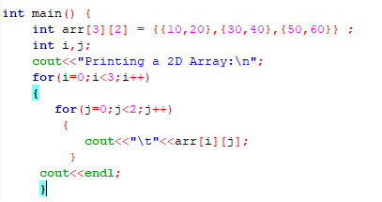

2D Arrays...

Slide 8
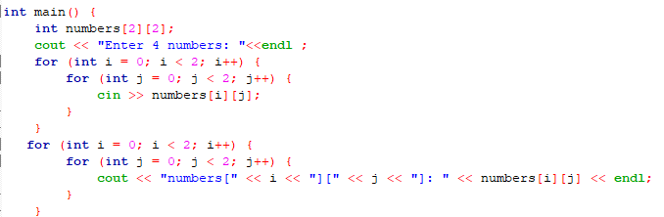
2D Arrays...

